Slide 1
Web3.js
How to use web3 js to deploy your contract

Slide 2
Today
Using ganache
Useing web3.js for deployment
Create CLI tool for interaction with contract

Slide 3
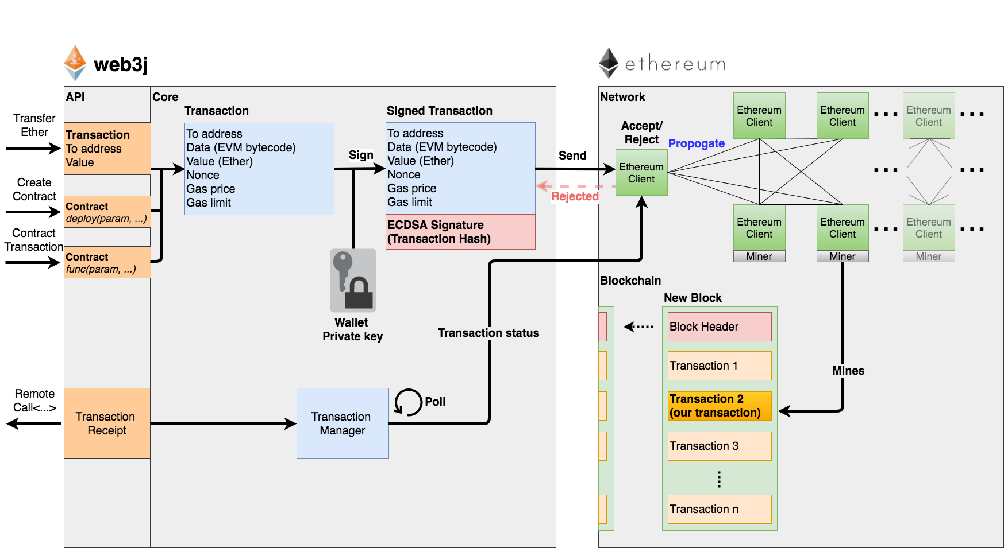
Ethereum transaction

Slide 4
Deploy in details
Smart-contract compiles to bytecode
Client crates raw transaction with bytecode, gasPrice, gasLimit, Nonce, To, Value
Client signs the transaction with his private key
Client sends http request to ethereum node with signed and serialized transaction. (eth_sendRawTransaction)
Client polls node for transaction receipt (eth_getTransactionReceipt)

Slide 5
Homework
Roulette game: create smart contract that will give a prize to those senders who predict the random number
Smart-contract should have a function:
Bet(uint a, uint b) payable
Where a < b, b – a > 4, 0 <= a, b <= 100
User sends ether to this function, amount = BET
Function generates the random number RNG
in case if: a <= RNG <= b : players receives back prize
that equals to: BET * (b – a + 1) * 98.5%
Else: player loses his bet.

Slide 6
Homework 2 *
Create a CLI tool that deploys this contract to the development network
Create a CLI that sends transaction `bet` to contract
Smart-contract should be upgradeable
Create CLI tool that will upgrade the contract logic

